Slide 1
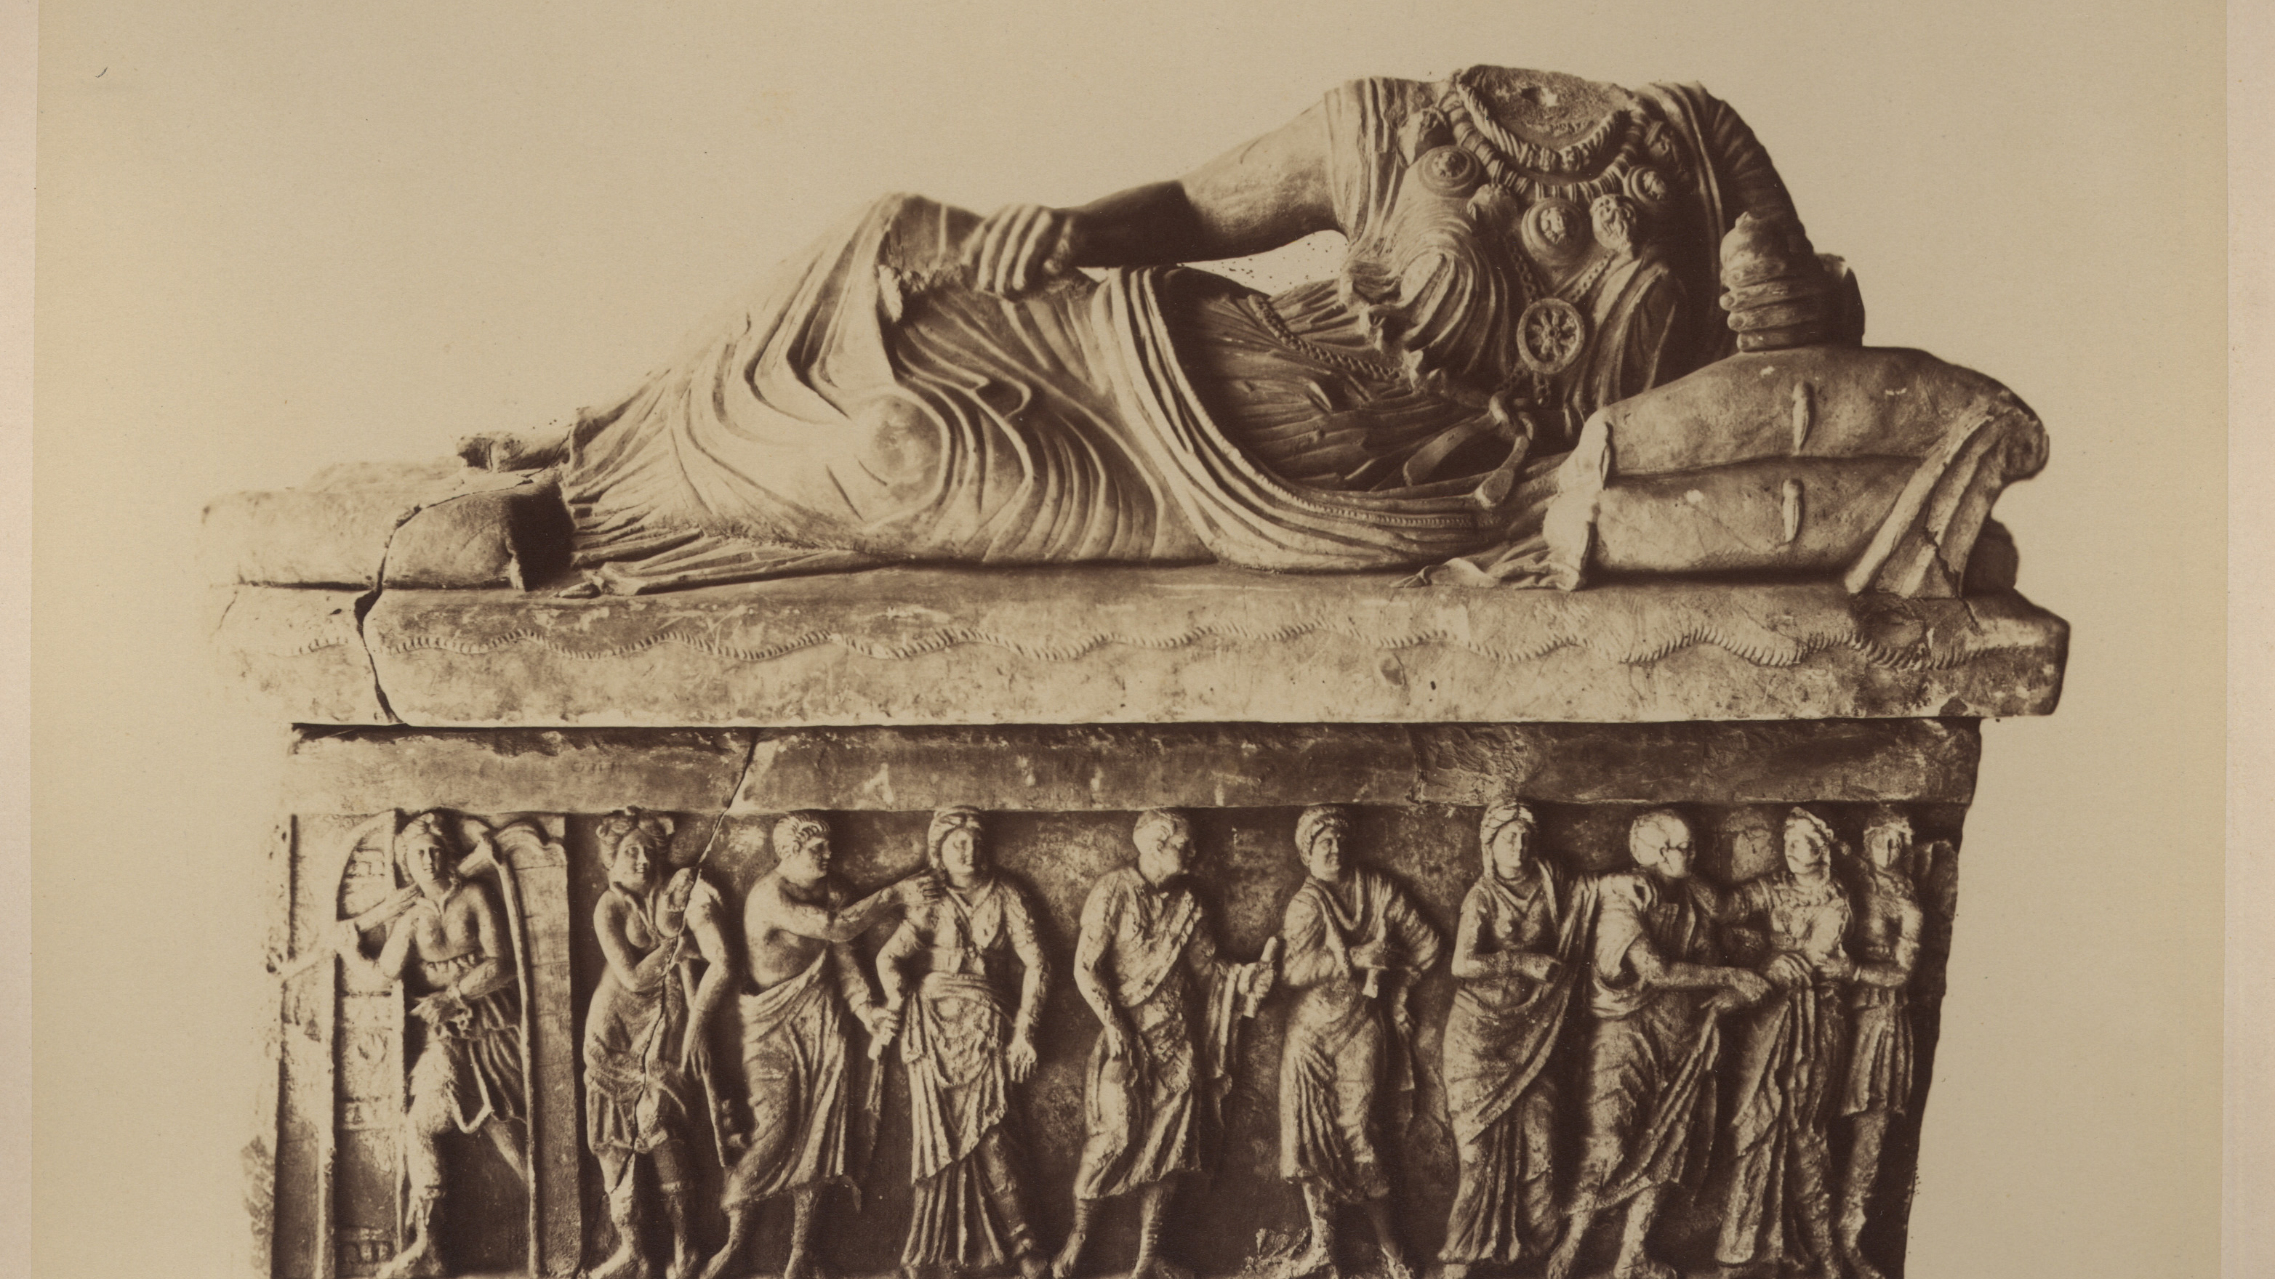
Partizione Antica
Looking for a XIXth century art historian
Enrica Zani – University of Bologna former student
PHAROS: The International Consortium of Photo Archives
Digital Art History Projects Showcase - November 8, 2023

Slide 2
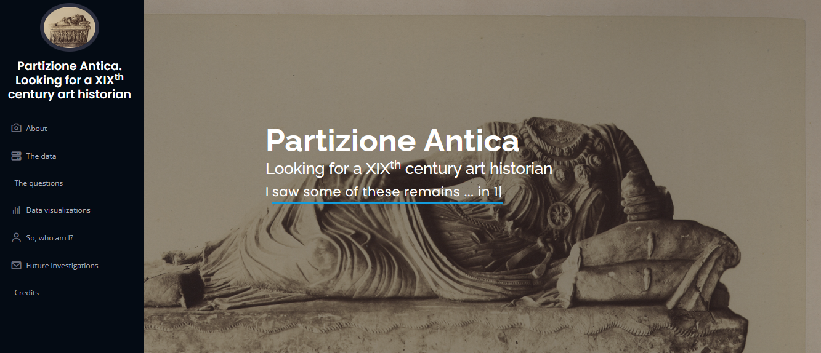
https://enri-ca.github.io/EPDS_EZ website
https://github.com/enri-ca/EPDS_EZ github repository
https://github.com/enri-ca/EPDS_EZ/blob/main/EPDS_EZ.ipynb Jupiter Notebook

Slide 3
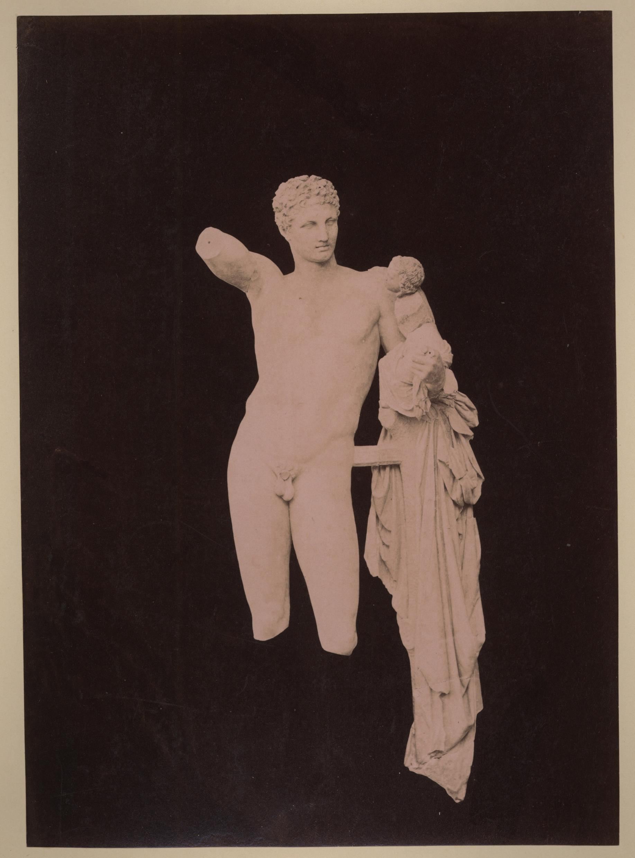
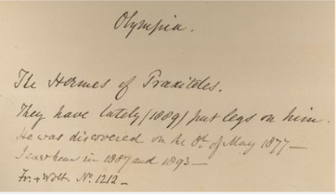
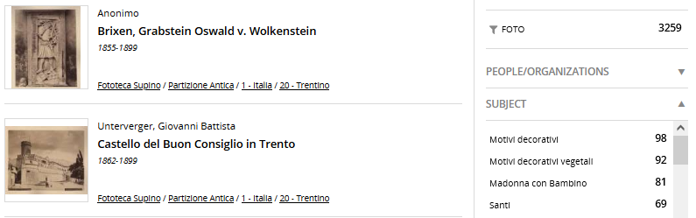
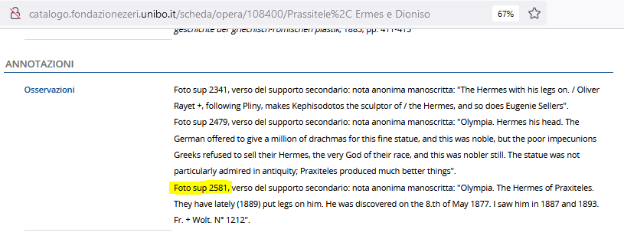
About
Anonimo <1855-1920>. 1877. [Ermes Di Praxiteles : Museo Archeologico : Olimpia. sup 2581 - PA Grecia II 040
The Partizione Antica is a series counting about 3000 photographs of the Fondo Supino art photo archive belonging to the Biblioteca delle Arti (Università di Bologna)
The photographs often carry on the verso side, handwritten annotations in English from the same hand
The photos have been described according to scheda F and OA models: the metadata and the digitalization of the photos are accessible from the Zeri Fundation catalogue
Annotations are partially transcribed in OA entries
The series has been quite well studied and treated in the past
But the original collector identity remains unknown

Slide 4
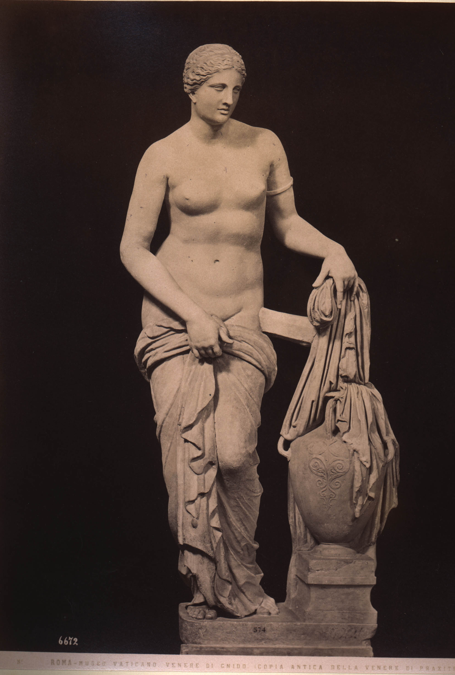
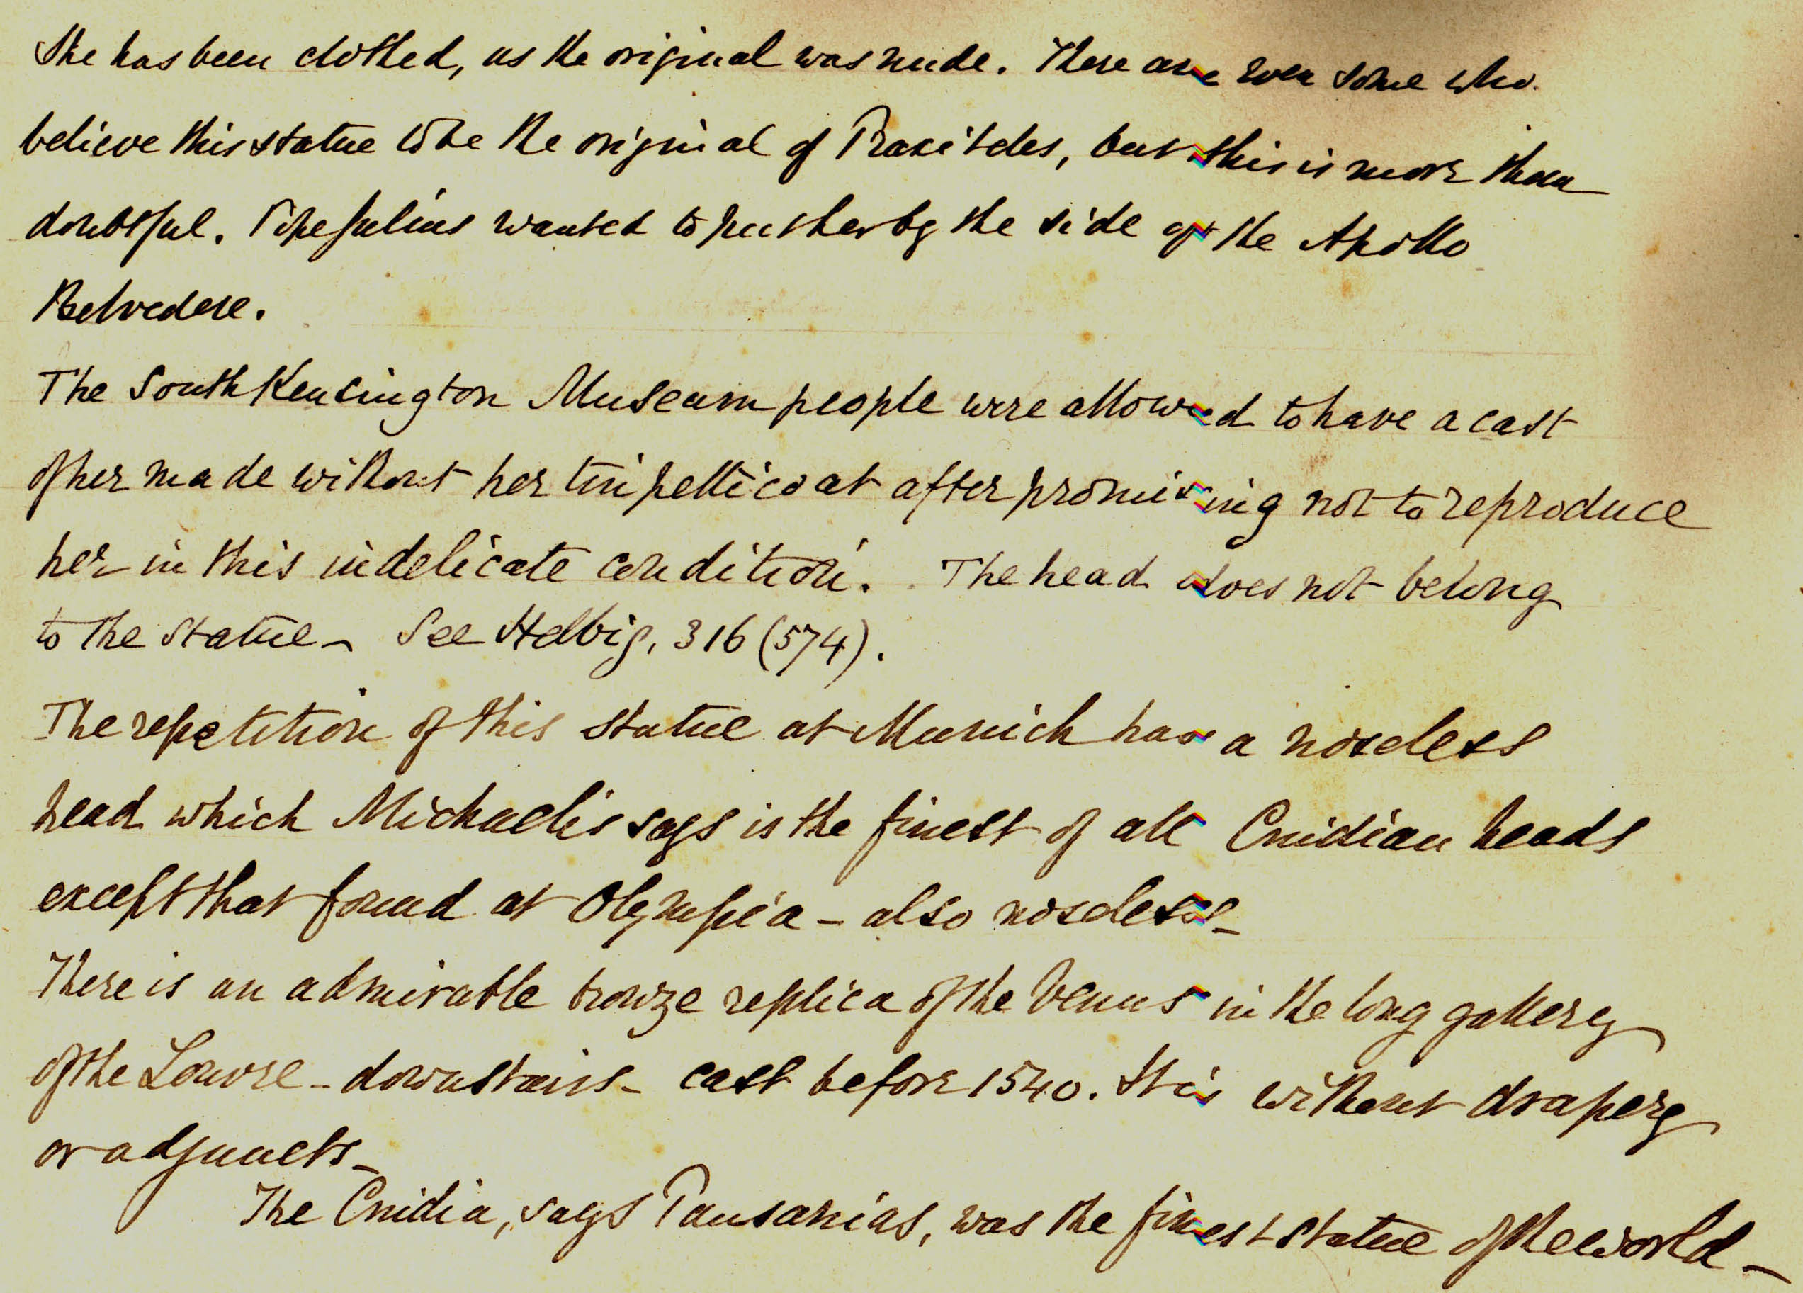
The question
Anonimo <1854-1916>. 1876. Roma : Museo Vaticano : Venere Di Cnido (Copia Antica Della Venere Di Praxitele). Alinari <Fratelli Alinari>. sup 733 - PA Roma II 063
Who is the art historian creating the “Partizione Antica”?

Slide 5
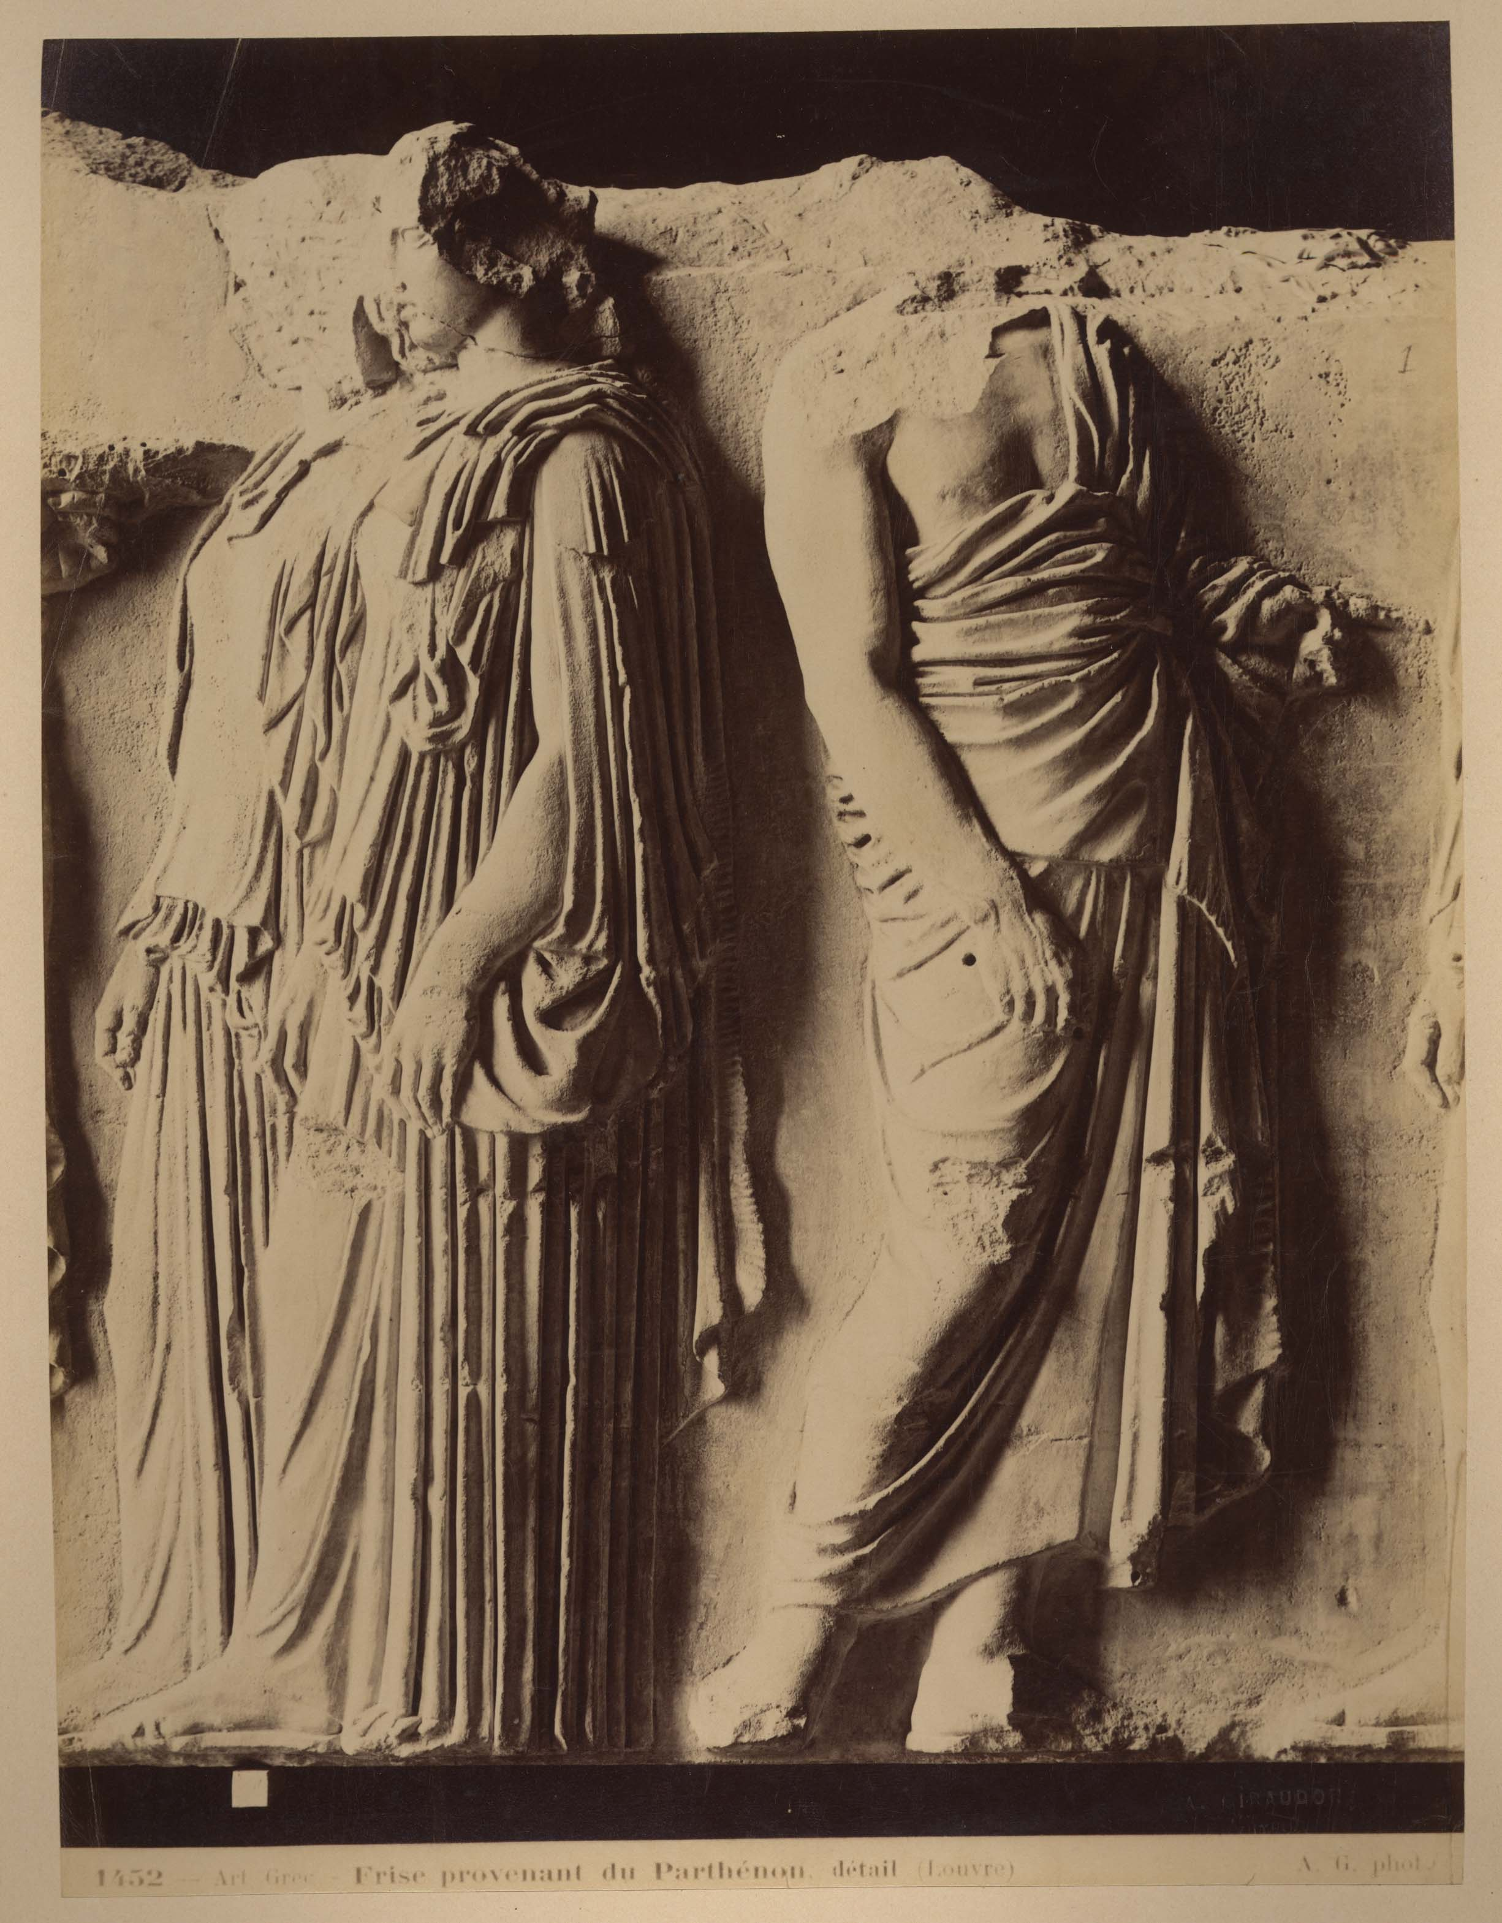
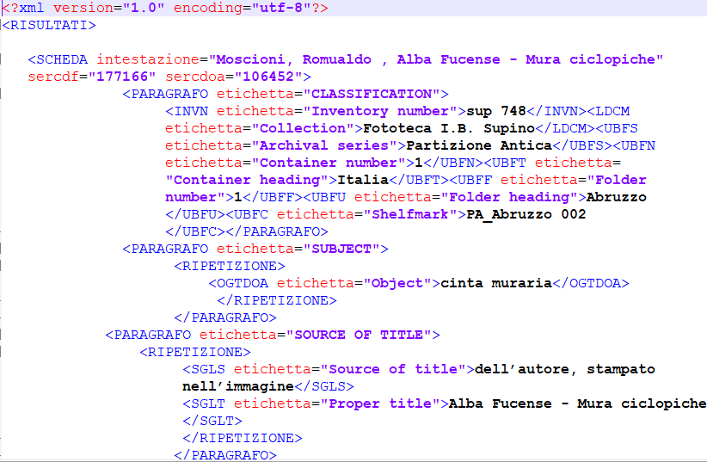
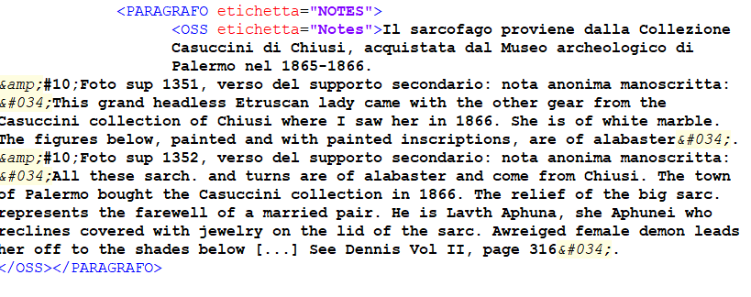
The Data
XML Structured metadata from an extraction of 3.232 F and 2.634 OA records of the Zeri catalogue
Unstructured data (free texts transcribed annotations – 1.838) have been extracted from a specific field of OA structured metadata

Slide 6
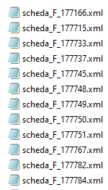
Data preparation
STEPS
creation of unique xml files for all the F and OA entries extracted
extraction of relevant information for the project from nested xml structure
extraction of unstructured annotations from OA data
creation of a new database merging data from the two previous steps
ISSUES:
Different Focus working on photographs as archival objects instead of according to a works of art point of view
Annotation transcribed in OA entries instead of in their related F entry
Need to rebuild connections between annotation and actual photograph

Slide 7
Data elaboration
STEPS
Photographer: enhancing their information (workplace, timespan of activity, etc.)
Places: enhancing their geolocation
unstructured annotations: seeking for further analysis elements running NLP and NER libraries
ISSUES:
Time saver having access to already realized AF or entry data in LOD
Working on a sample of annotations, sometimes incompleted, transcribed with a work of art focus

Slide 8
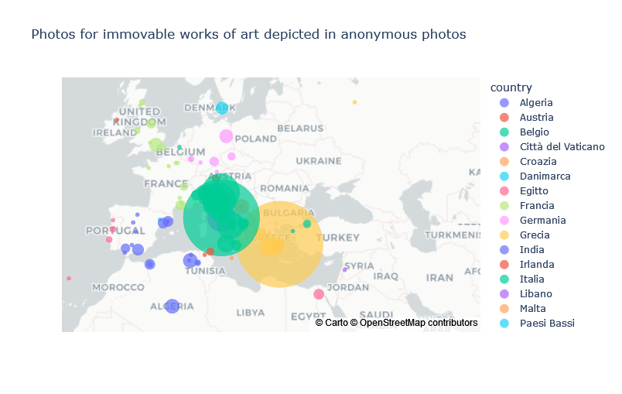
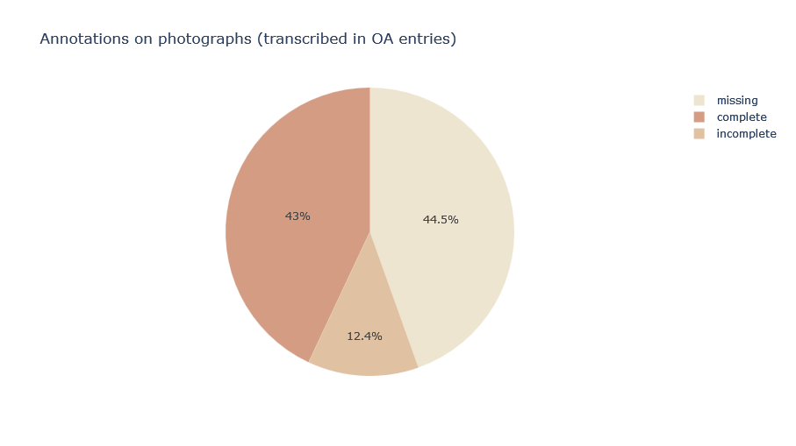
Results from structured metadata
Interest for funerary sculpture and sarcophagus.
Interest in Mediterranean area
Extra-European little photos’ set about India (18 photographs)
Transcribed annotations
for more than
50% of photographs
47,5% photos from relevant art history photographers (Alinari, Brogi, Sommer, etc.)
Relevant presence of anonymous photos (49%) and 100(/111) other named photographers

Slide 9
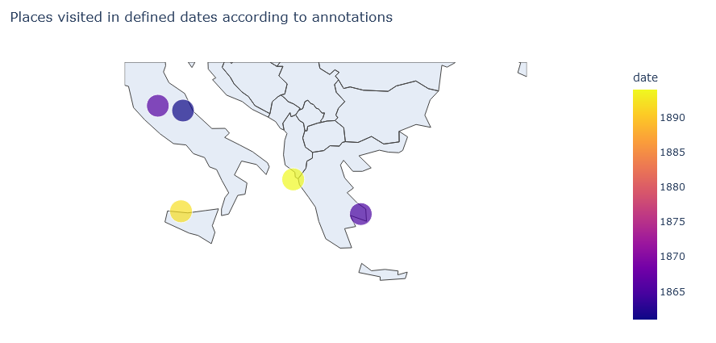
Results from unstructured texts
matcher.add("PA_creator", [[{"LEMMA": "I"}, {POS: 'VERB'}]])
22 occurrences
6 place-time references to personal experiences
6 ownership declarations (5/6 about medals +1/6 about missing photo)
10 opinions
I told the Countess Marcello (nee Grimani) that I respected her immensely on account of this statue of Agrippa. This was in Corfù in March 1894. (sup 1811)
I have a medal of him with the inscription: / "Antonius de Royzellis monarcha sapientie"
(sup 659)

Slide 10
Summary of results
Unexpected results that can be used for further investigations
Results confirming already known information
The “unknown collector” was interested in funerary sculpture and sarcophagus.
He/she has also an extra-European interest about India (18 photographs)
The “unknown collector” was interested in Mediterranean area
Places of shooting of anonymous photos do not show significant differences from the general collection
She/he was provided of photos from several minor named photographers (less than 20 photos each)
The number of annotations is higher on photos depicting IV-V BC. works of art, confirming her/his interest in ancient art.
NER related to dates confirm their activity in the second half of XIXth century
It has been possible to detect 6 place-time pairs attesting their presence movements.

Slide 11
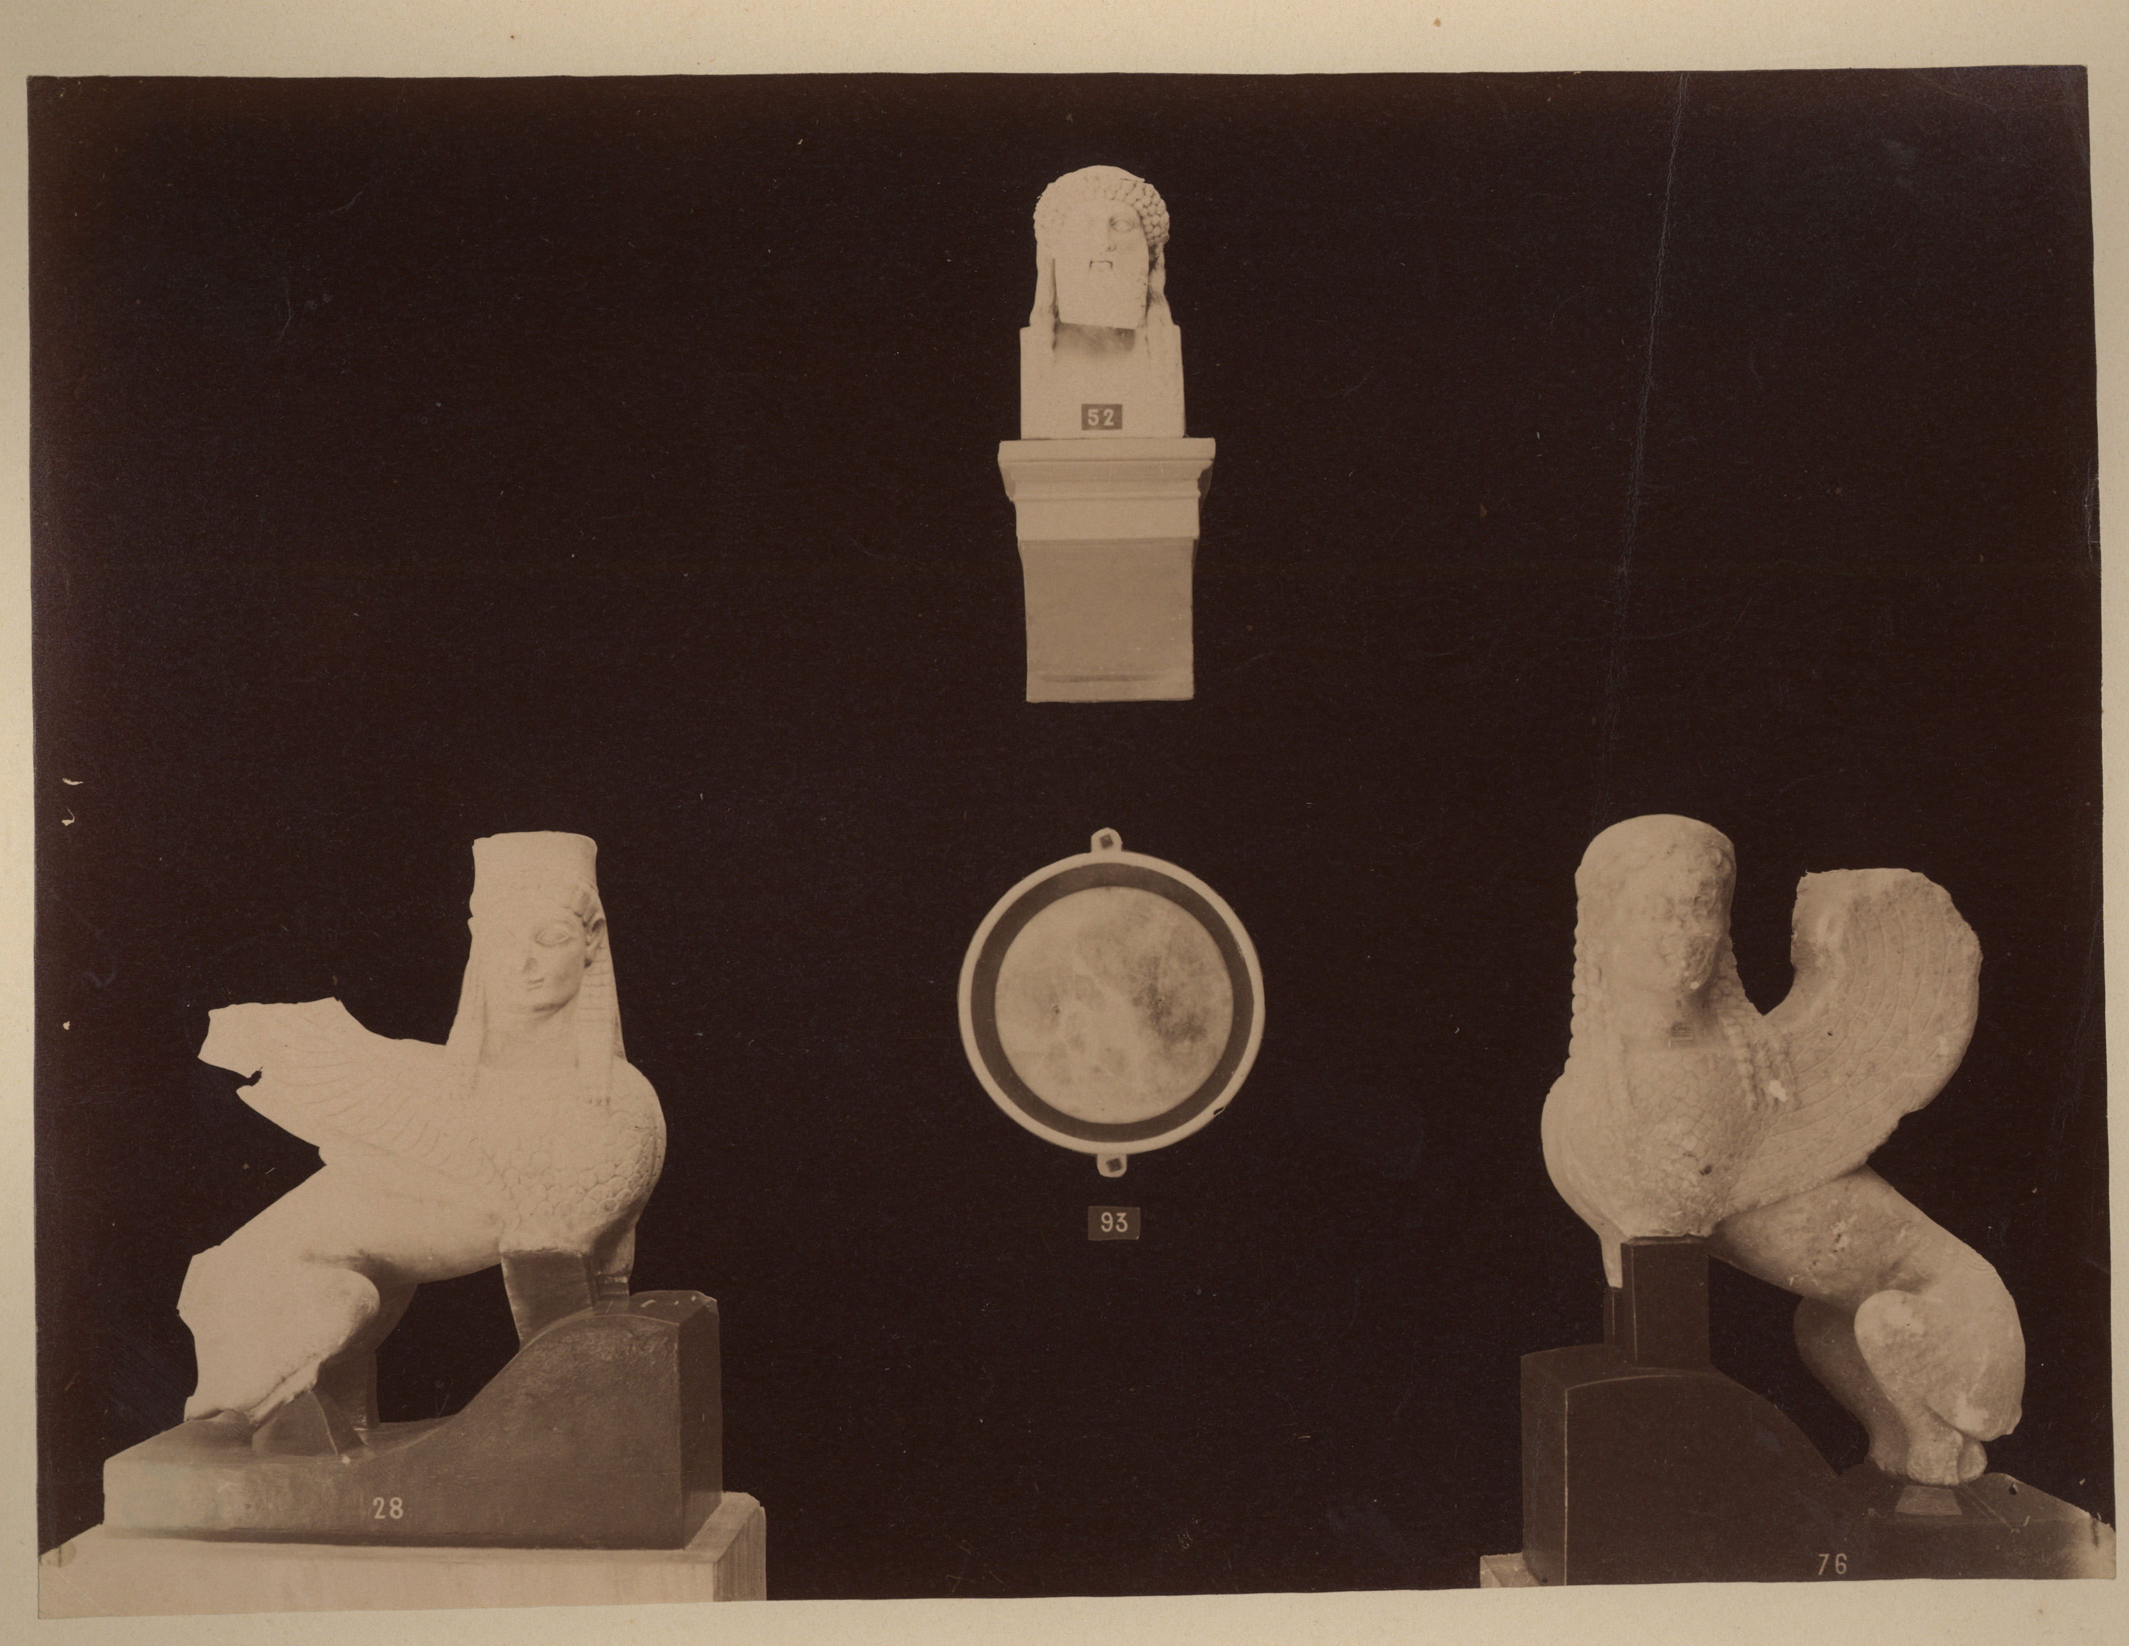
Thank you!

